Slide 1
Alton Redbirds Basketball
2022-2023 Parent Meeting
November 21, 6:30 pm, AHS Library

Slide 2
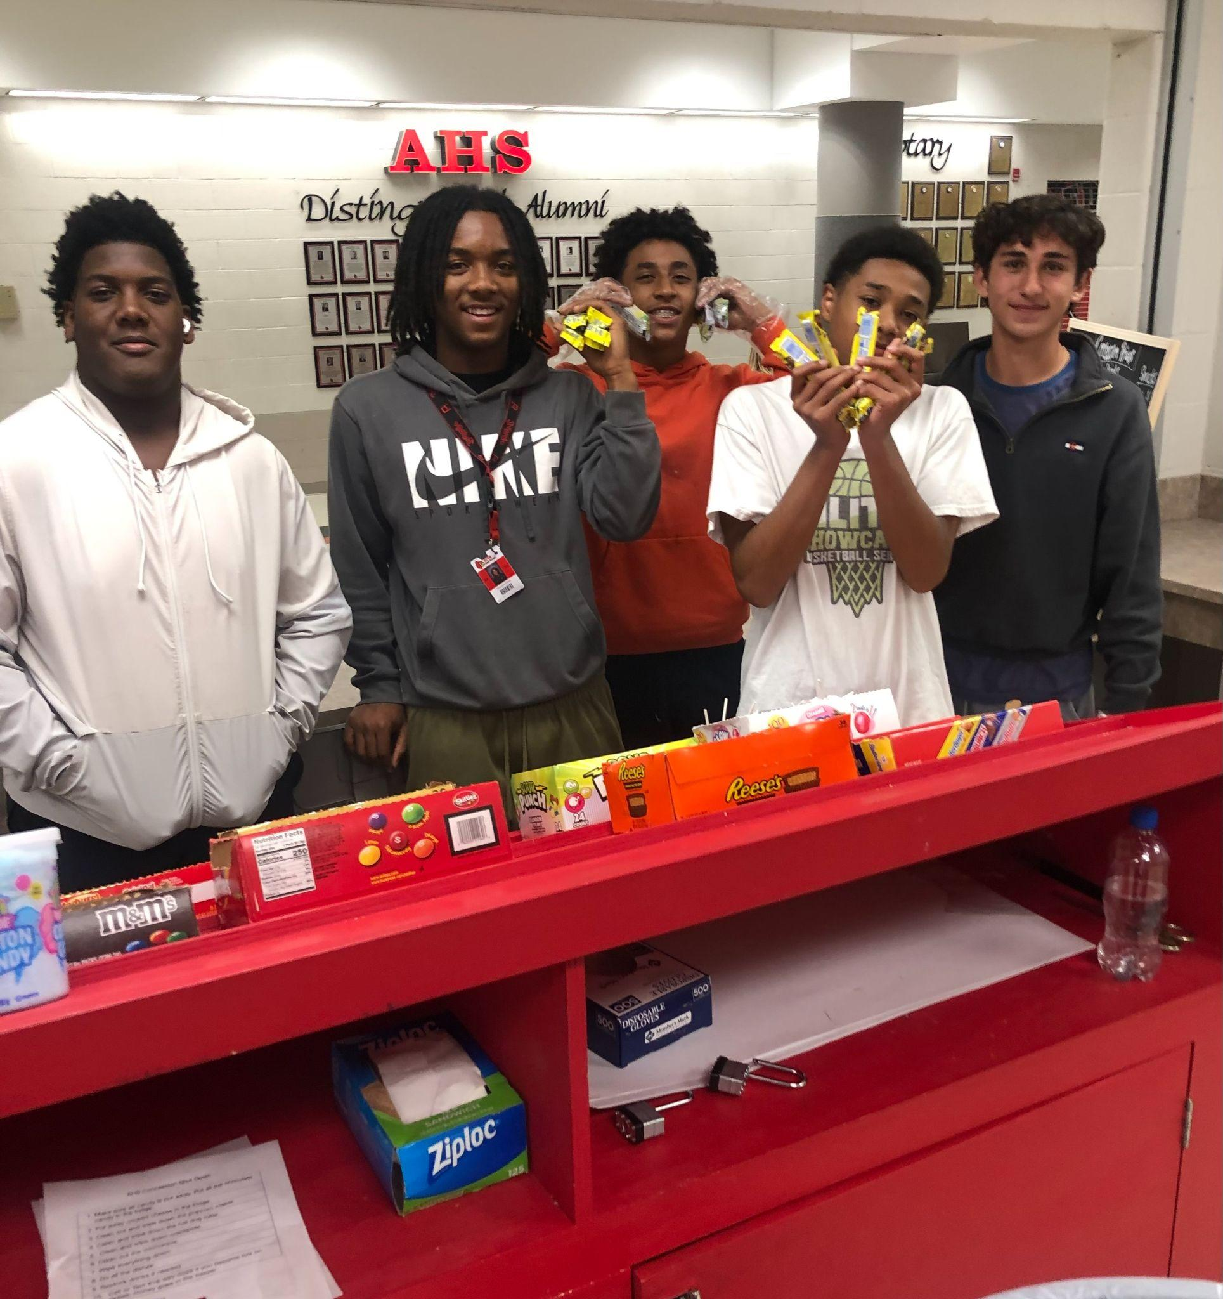
Coaching Staff
Head Coach - Dylan Dudley
21 years of experience
1600 wins,
38 conference titles,
2 national championships,
4 state titles,
28 pros
Bank presidents, teachers, farmers, administrators
Sullivan High School, Illinois College

Slide 3
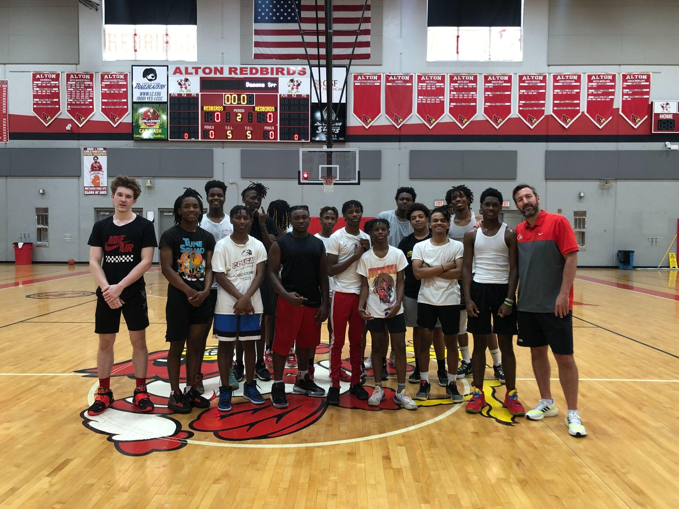
Coaching Staff
Head JV Coach - JaQuail Townser
Head Sophomore Coach - Tony Bradley
Head Freshman Coach - Ethan Bray
Strength & Conditioning Coordinator - JR Lawrence

Slide 4
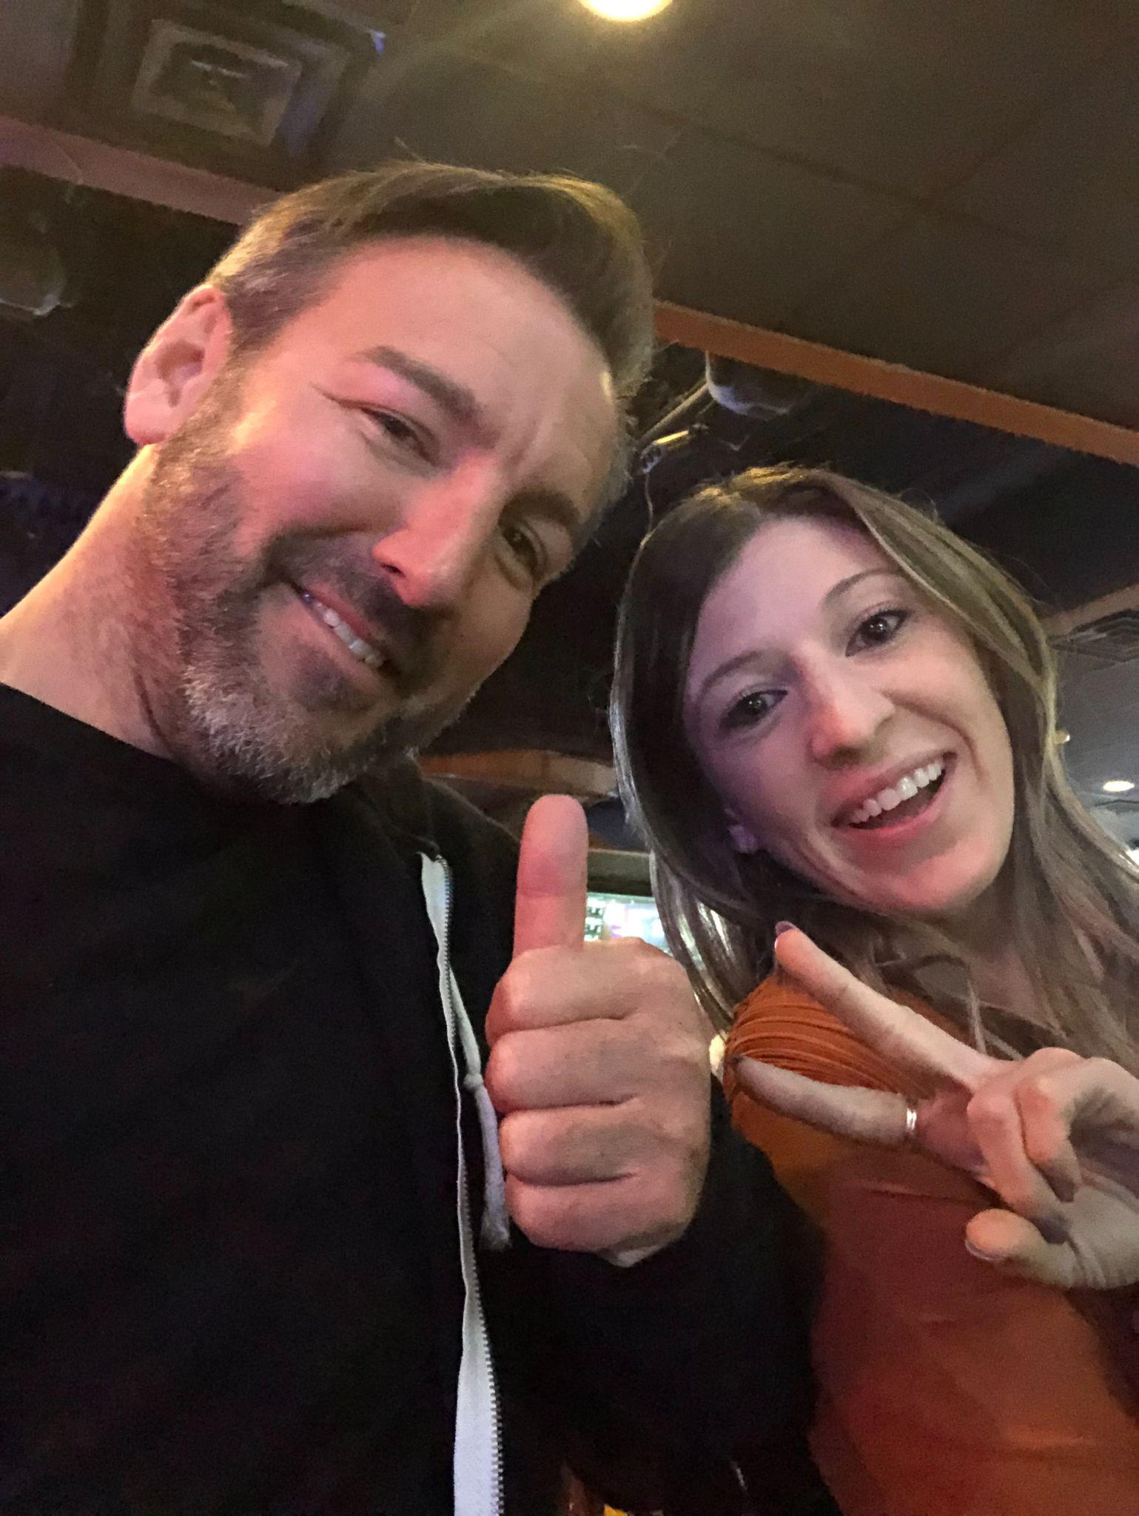
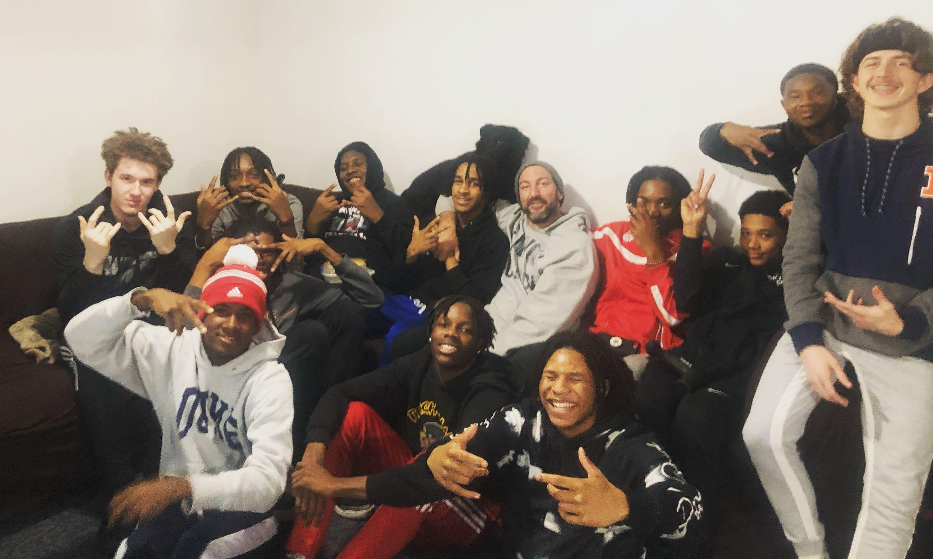
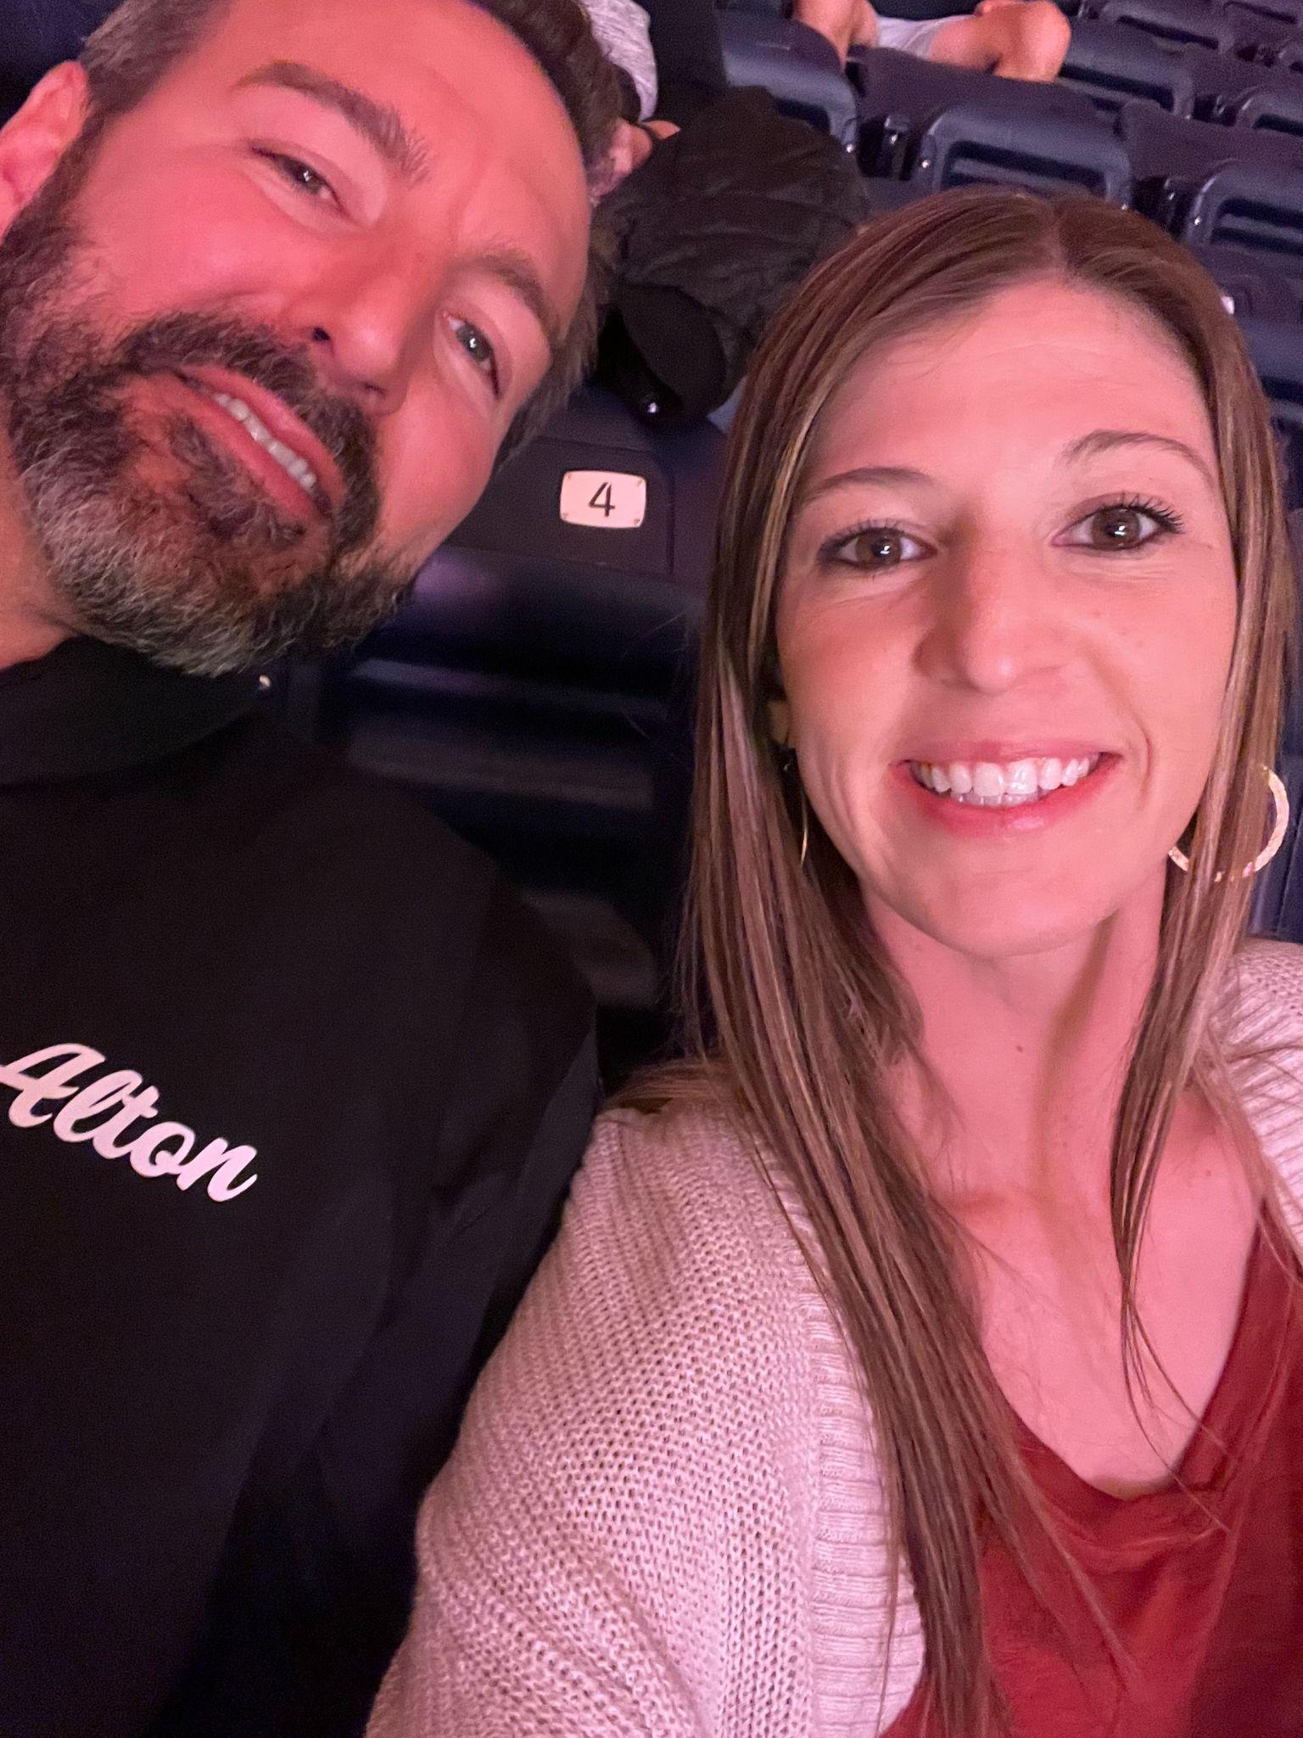
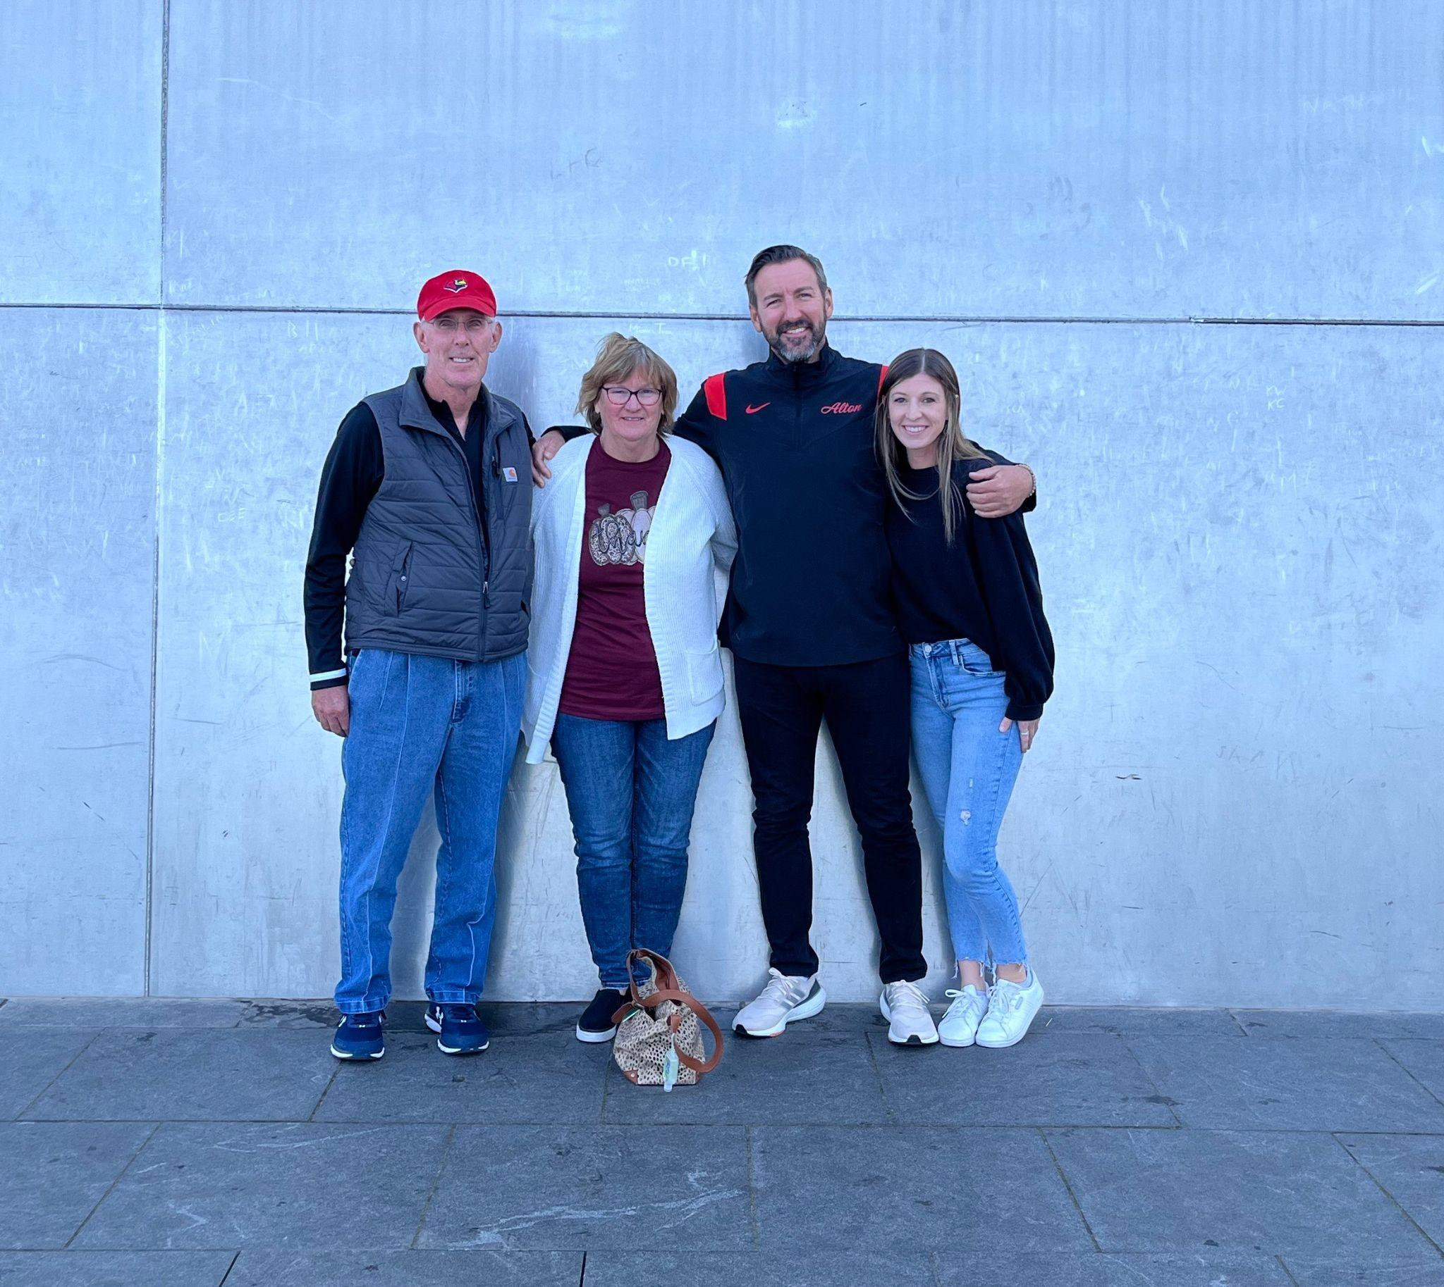
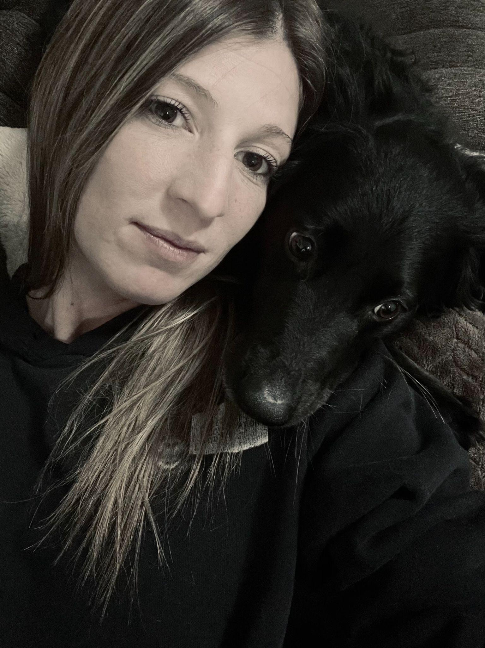
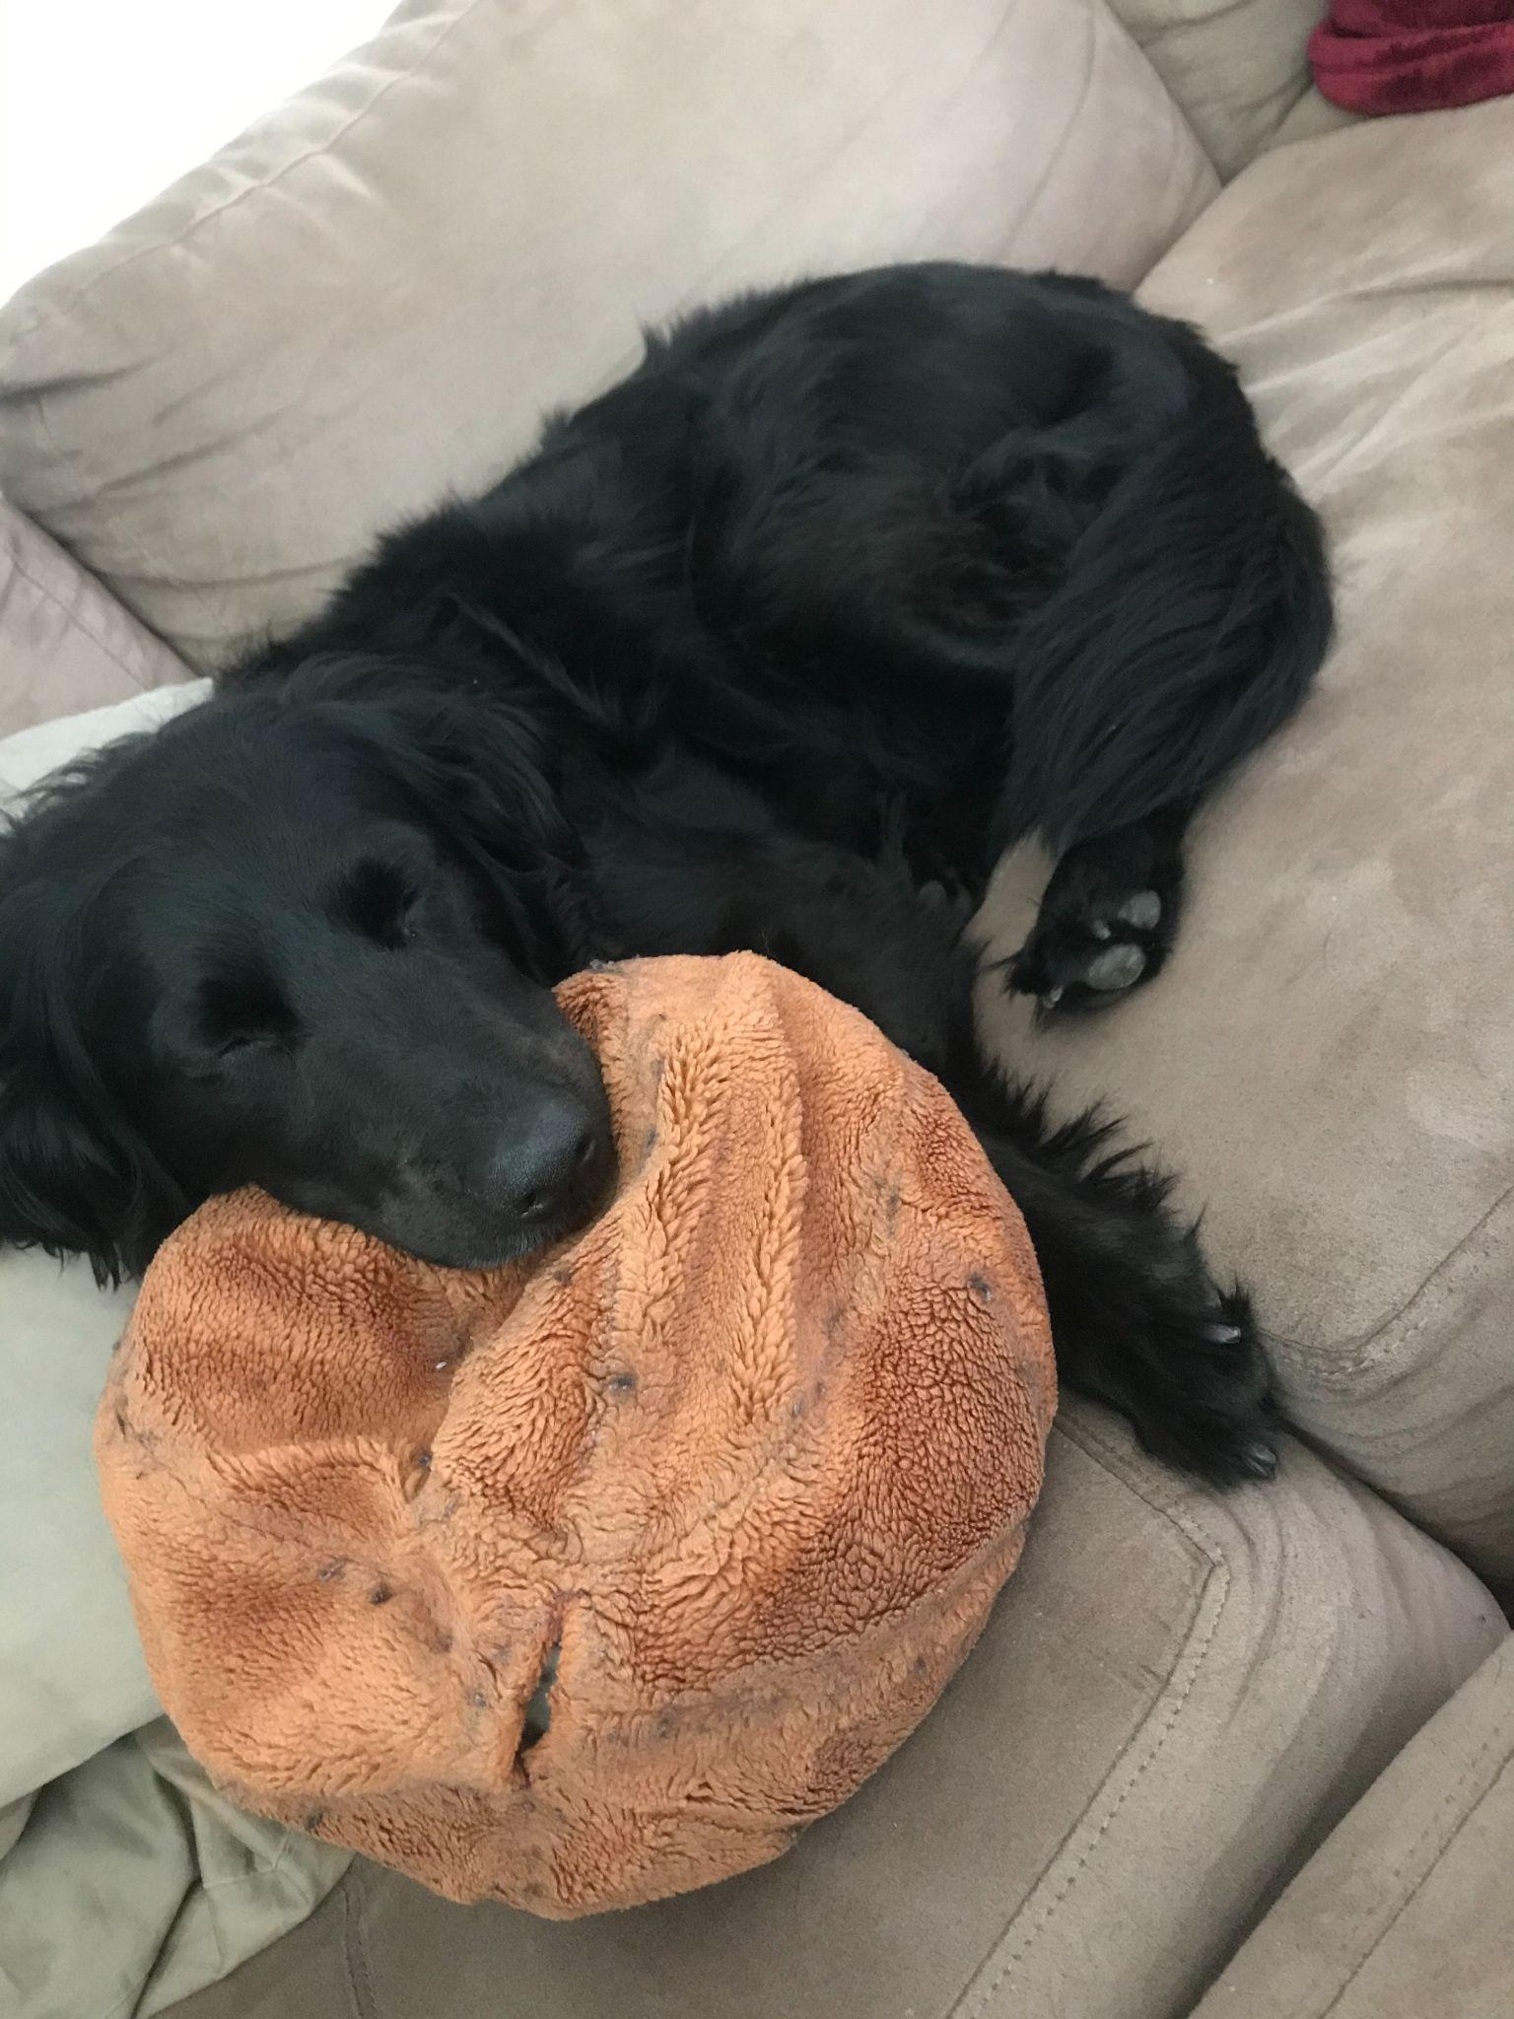
My
Why…

Slide 5
No Excuses
Be where you're supposed to be and be there when you’re supposed to be there!
Practice
We will practice over Thanksgiving and Christmas break
Weights
Two times a week during the season
Three times a week off season
School
We do NOT miss school
We do NOT show up late to school

Slide 6
Injuries & Sickness
Injuries
Call me
Utilize our athletic trainer, Andy Renner
Emergency room/doctor visit
Game injuries
One Day Sickness
No such thing as one day sickness

Slide 7
Transportation
All Redbirds basketball student-athletes will ride the bus to all away games.
Away games transportation
Student-athletes may travel back with their parents only.
Sign out sheet available after each game.

Slide 8
Academic Success
No Ds or Fs
Google Classroom/Skyward
Study Hall
To Be Determined
Eligibility
Coaches Discretion
How to succeed in school?
Show up everyday on time PREPARED
- Chromebook, pen/pencil
Turn in all assignments
- Late better than never
Engage your teacher
- Hello, Hi
- Answer one question

Slide 9
Program
Fundraising
HundredX Campaign
Each player responsible for $300
$2 per review
10 people compete 15 reviews
Each review takes ONE minute to complete
Email is never shared

Slide 10
Coaching Expectations
How we coach?
Tell ‘em the truth
Attempt to love ‘em more than you
Hold them accountable
What we expect from you?
Show up everyday
Tell the truth
Hold us accountable
It takes a village!

Slide 11
Player Expectations
#samedudeveryday
Have a GOOD attitude and give a GREAT effort
Be a GREAT teammate
People will forget what you said, people forget what you did, but people will NEVER forget how you made them feel
Be Tough, Compete, Have Fun
Soft & Selfish will never play here
“Huddles, high fives, have fun!”

Slide 12
Playing Time
Your son will know why he is playing
Your son will also know why he is not playing
Two issues in seven years
My job is to make my coach play me.
- Shane Battier

Slide 13
Parent Expectations
“Does he really think I’m listening to him?”
Clap your hands!
Positive voice!
Biggest fan!
The Team, The Team, The Team
Your son will not play if you want to coach from the stands
Your son will not play if you want to act out
“I wish he would just be quiet!”
“How embarrassing, right?”
“She doesn’t even know what is going on.”
“He really believes I’ll play better if he just yells like a fool!”

Slide 14
Program Needs/Wish List
Freshmen Uniforms $1800
Sophomore Uniforms $1800
Hudl Assist $800
Dr. Dish , 2 total, $8000
Replace original Dr. Dish
Trade in second machine for updated model
JV Uniforms $1800

Slide 15
Program Building 101
How to build a program
Eliminate selfish people, players, families
Hold them accountable
Demand excellence
Have a plan
“Team Together”

Slide 16
Lessons in Leadership
Leadership 101
Leadership does not come from meetings or books, it comes in your daily actions and the standards you fight for on a daily basis
Leadership is a lonely place, comes with all things good and bad
Conflict is never a bad thing when addressed properly
This is not about being right or wrong
“If you want to make everyone happy or be friends with everybody go sale ice cream.”

Slide 17
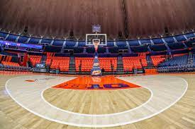
No Skipping Steps
https://twitter.com/aggiembk/status/1591059429054902273?s=51&t=wKiAHUPk7agXIdXY0sfdrg

